Slide 1
Overview of JS, TS, jQuery and responsive design for Hybrid Mobile Apps
COMP3097 Mobile App Development II
Week 9

Slide 2
Web apps
Solve some of these difficulties by being inherently cross-platform (as long as web standards are adhered to).
Any HTML, CSS, and JavaScript knowledge you might have can be leveraged, so there may be less to learn at the outset.
They have very limited access to the capabilities of the device
They are slower than native apps (given that they run inside a browser using an interpreted language, JavaScript)
Don't inherit the native look and feel of the app
Discovery is not simple

Slide 3
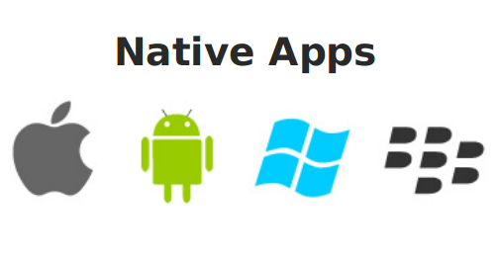

Slide 4
Native application
Works by leveraging the built-in system frameworks present on the device
Written in languages that are compiled for quick execution, such as Objective C/Swift or Java
They use the built-in frameworks, they get a lot of features (including look and feel) nearly for free
Not portable to other platforms

Slide 5

Notes:
TODO: find something similar

Slide 6
Hybrid applications
Try to be the best of both worlds.
Since hybrid apps use some native code, the app has access to the native features of the device.
App stores will allow the app in their stores, allowing easy discovery.
Because hybrid apps use web technology, your code is largely cross-platform (assuming you follow the Web standards), and easy to port to other platforms.
Web portion of a hybrid app will likely still run slower than a native app

Slide 7
Architecture

Slide 8
Client-server architecture
Web server
Protocols and UIs
Websites
Application server
Applications – business logic
Database server
Application’s data storage
Notes:
Client applications can be built in various technologies and using all kinds of tools. Our cross-platform hybrid apps can also work in client-server architecture.

Slide 9
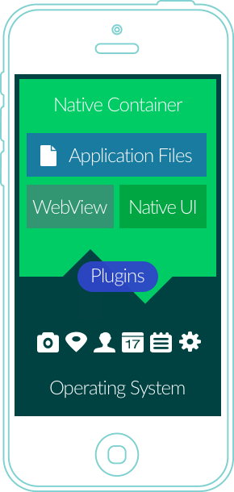
Hybrid app architecture
Cordova uses a WebView
WebView is embedded in the native wrapper
Plugins allow access to selected features of the operating system
Plugin mechanism allows for extensions to be build

Slide 10
Tools

Slide 11





Tools that we will require
Node.js
PhoneGap/Cordova
Ionic
Angular.js/React
VisualStudio Code
Note that you can use React with Ionic as well

Slide 12
Installation
Install node.js (https://nodejs.org/en/download/)
Use the following command to install Cordova and Ionic framework
npm install -g cordova ionic
Notes:
Ionic and Cordova can be installed using several tools. We will use one that you use in other courses: node.js and the console command npm

Slide 13
Project and templates

Slide 14
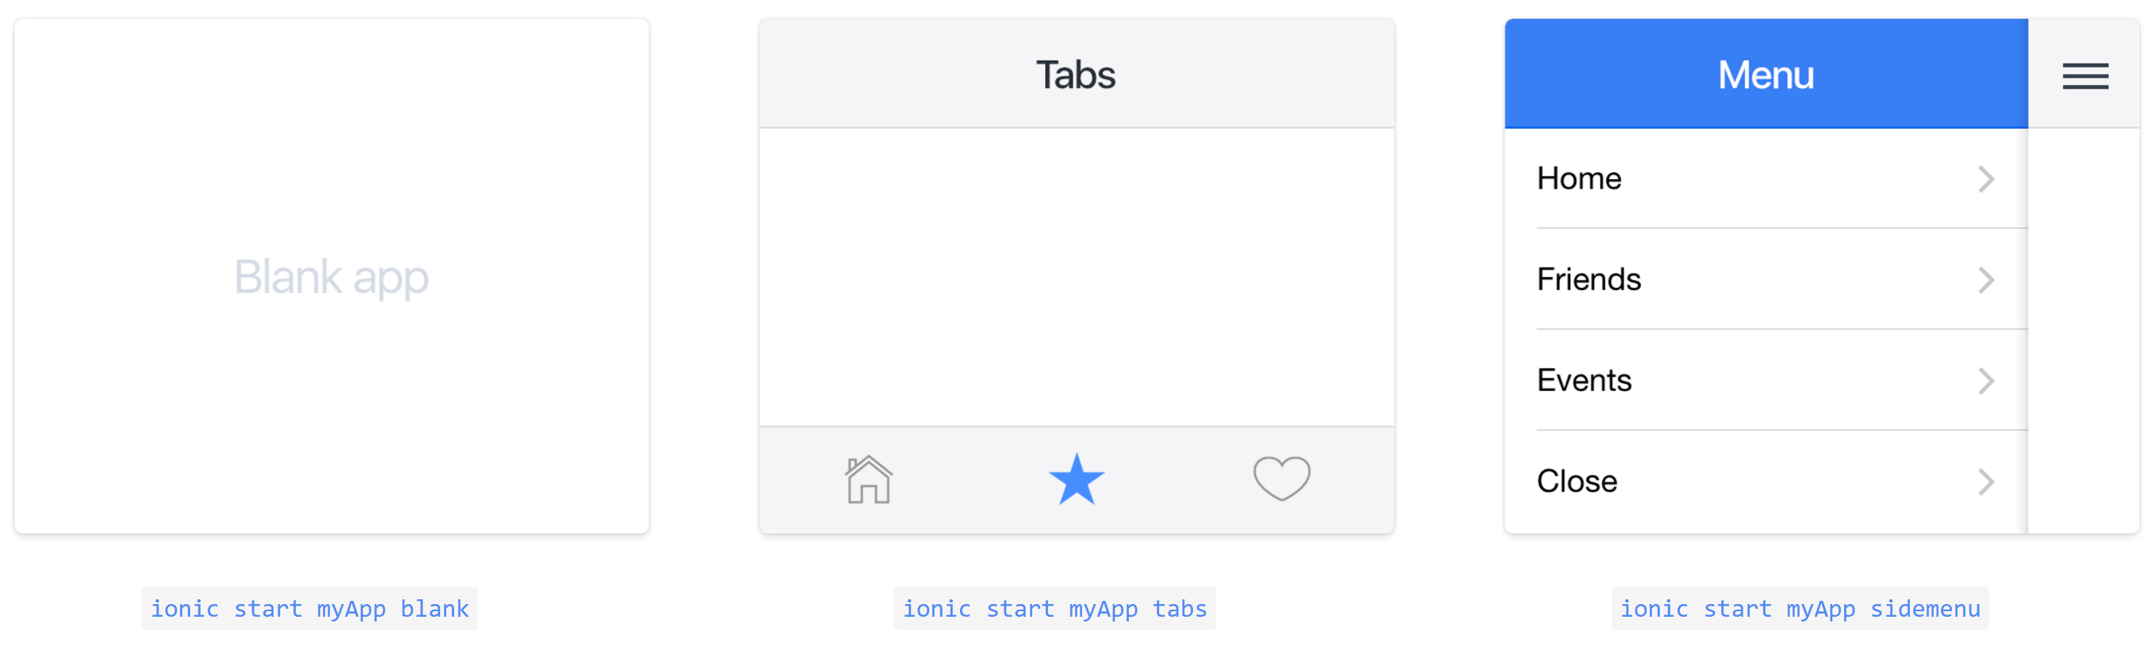
Start project
ionic start myApp tabs
Notes:
Ionic provides you with several templates to start with. Blank application is exactly what the name suggests: project structure without any activities/classes instde; Tabs and sidemenu provide you with predefined navigation structure. In the creation process, you will be asked about the base framework (Angular or React)

Slide 15
This week
Media querries
JavaScript review
Introduction to TypeScript
types
classes
Interfaces

Slide 16
Media queries

Slide 17
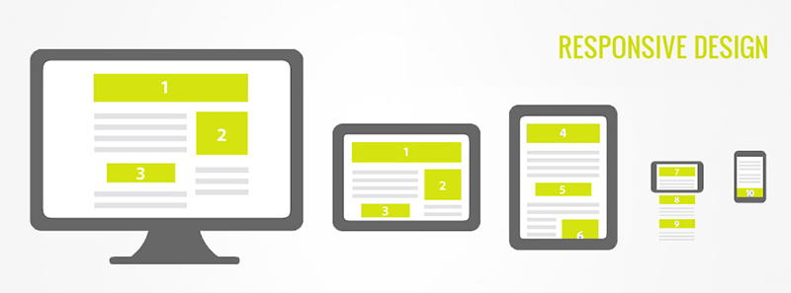
Responsive design for web
Notes:
Building cross-platform development applications developers and designers have to deal with various screen sizes and resolutions. With Angular/Cordova/Ionic we have to use the CSS features to handle those differences.
Designing responsive UI, we have to remember that adjustment to different size/resolution may require not only modification of the content size, but sometimes also hiding some content or replacing it with alternative version. For example, we use different resolution of images for different screen sizes. Similarly, we can use different versions of video files as well as different layouts of the content.

Slide 18
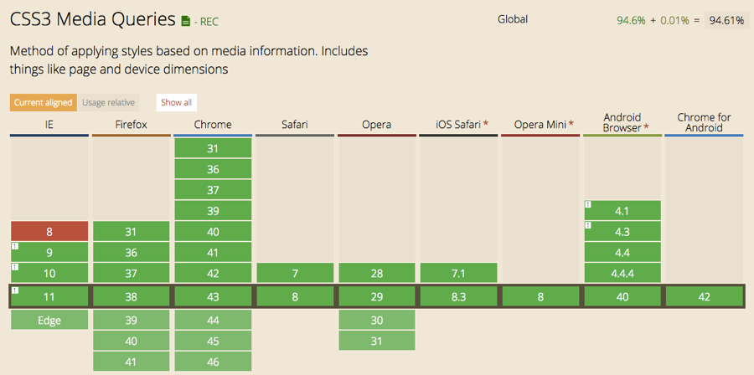
Notes:
http://caniuse.com/#feat=css-mediaqueries

Slide 19
Media query
Media query is a CSS technique introduced in CSS3.
It uses the @media rule to include a block of CSS properties only if a certain condition is true.
@media only screen and (max-width: 500px) { body { background-color: lightblue; } }
Notes:
The following code sample will show you how the media query is triggered when the width of the screen changes.
<!DOCTYPE html>
<html>
<head>
<meta name="viewport" content="width=device-width, initial-scale=1.0"/>
<style>
body {
background-color:lightgreen;
}
@media only screen and (max-width: 500px) {
body {
background-color:lightblue;
}
}
</style>
</head>
<body>
<p>Resize the browser window. When the width of this document is less than 500 pixels, the background-color is "lightblue", otherwise it is "lightgreen".</p>
</body>
</html>

Slide 20
Basic syntax
Defined in CSS or HTML file
@media not|only mediatype and (media feature)
{ CSS-Code; }
Defined in HTML when importing file
<link rel="stylesheet" media="mediatype and|not|only (media feature)" href="mystylesheet.css">
Notes:
The basic syntax of the media query requires us to specify media type and the media feature – these two elements act as a filter or trigger definition. For example @media only screen and (max-width: 500px) will be triggered only for screens with the with of 500pixels or less.

Slide 21
Media query
@media only screen and (max-width: 500px) { body { background-color: lightblue; } }
Media type
Media feature

Slide 22
Media types
Value | Description
all | Used for all media type devices
aural | Deprecated. Used for speech and sound synthesizers
braille | Deprecated. Used for braille tactile feedback devices
embossed | Deprecated. Used for paged braille printers
handheld | Deprecated. Used for small or handheld devices
print | Used for printers
projection | Deprecated. Used for projected presentations, like slides
screen | Used for computer screens, tablets, smart-phones etc.
speech | Used for screenreaders that "reads" the page out loud
tty | Deprecated. Used for media using a fixed-pitch character grid, like teletypes and terminals
Tv | Deprecated. Used for television-type devices
Notes:
In this table shows possible options of media types. Notice, how standard changed limiting the list to only 4 options.

Slide 23
Media features
Value | Description
aspect-ratio | The ratio between the width and the height of the viewport
color | The number of bits per color component for the output device
color-index | The number of colors the device can display
device-aspect-ratio | The ratio between the width and the height of the device
device-height | The height of the device, such as a computer screen
device-width | The width of the device, such as a computer screen
grid | Whether the device is a grid or bitmap
height | The viewport height
max-aspect-ratio | The maximum ratio between the width and the height of the display area
See all: http://www.w3schools.com/cssref/css3_pr_mediaquery.asp
Notes:
With each media type, we have associated properties based on which we can build the condition. This table shows just a subset and a complete list can be accessed on the w3school.com website

Slide 24
Media queries example: grid system
Big screens
Small screens (<768px)
Set up sizes for the columns e.g.:
12 columns each 8.33% wide
6 columns each 16.66% wide
For each column define a class in your css
.col-1 {width: 8.33%;}
.col-2 {width: 16.66%;}
Decide what happens when the screen is smaller that your threshold
@media only screen and (max-width: 768px) {
/* For mobile phones: */
[class*="col-"] {
width: 100%;
}
}

Slide 25
Dealing with different screen sizes in Cordova

Slide 26
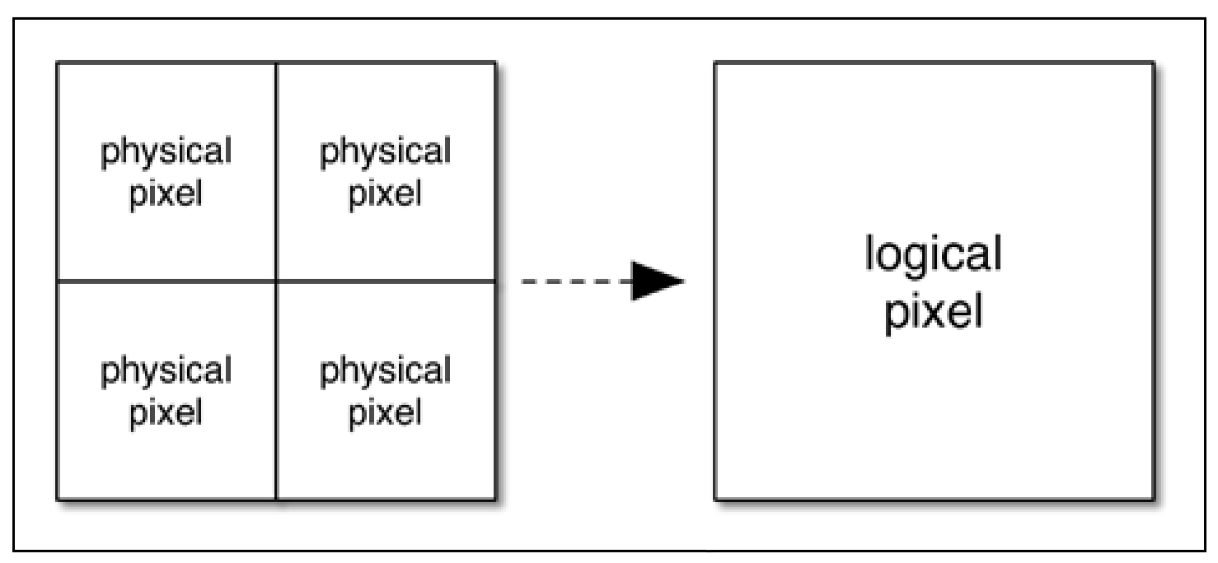
Problems
Resolutions: 600x800, 640x1136, 2560x1600 etc.
Aspect ratios: 4:3, 16:10 etc.
Notes:
Additional issue that we have to deal with working with cross-platform development, is the fact that different vendors have own definitions of logical pixels – the way how physical pixels of the sceeen are presented to the software.

Slide 27
Dealing with issues
Response 1: scaling
Response 2: changing layout
Response 3: split view
Notes:
We can do three things in order to adjust to the changing resolution:
You can scale the content – modify the size of the font, images etc up or down, depending on the needs
You can change the layout – reorder elements and change their position or even hide some items
You can also split the content and distribute it between multiple pages as a result. Think about your email client and its behavior when you rotate your phone between portrait and landscape positions, and how it switches from two columns (landscape) to two-screens combo (portrait)

Slide 28
Responsive design
Responsive design isn't limited to the width of a device; it can (and for hybrid apps, needs to) respond to the device's height as well.
Alternatively, it is often useful to respond to the device's orientation or screen quality and capabilities.

Slide 29
Positioning the content
Containers are block elements that contain other elements, perhaps even other containers
You want containers to attach to the edges of the screen or of their parent element. This means your containers need to be absolutely positioned using the position: absolute style
The attachments are specified using the top, left, right, and bottom styles. These specify offsets in pixels or other units from the edge of the parent (assuming the parent is in the absolute or relative position)

Slide 30
JS and TS
Notes:
Let’s compare two languages that are used in the development. Most of you knows JavaScript (JS) and after previous semester, you are also familiar with TypeScript (TS). We will only refresh this knowledge here.

Slide 31
JavaScript in a nutshell
A highly popular language used to build front-end and back-end (with node.js)
Part of the HTML5 trio: HTML, CSS, JavaScript
Case sensitive
JavaScript statements are composed of: Values, Operators, Expressions, Keywords, and Comments
Two types of values: literals and variabls (var)
Comments // single line or /* multiple lines */
Uses Unicode

Slide 32
Data types
Basic data types:
String, Number, Boolean, Array, Object
Casts values automatically
16 + "Volvo"; is actually "16" + "Volvo";

Slide 33
Access to output (web)
JavaScript can "display" data in different ways:
Writing into an alert box, using window.alert().
Writing into the HTML output using document.write().
Writing into an HTML element, using innerHTML.
Writing into the browser console, using console.log().

Slide 34
Finding element in the document
To access an HTML element, JavaScript can use the document.getElementById(id) method
The id attribute identifies the HTML element. The innerHTML property is used to access the HTML content of the element

Slide 35
Events
An HTML event can be something the browser does, or something a user does
An HTML web page has finished loading
An HTML input field content was changed
An HTML button was clicked
JavaScript lets you execute code when events are detected through handlers and callbacks.
HTML allows event handler attributes, with JavaScript code, to be added to HTML elements
<button onclick='document.getElementById("demo").innerHTML=Date()'>The time is?</button>

Slide 36
Prototypes
Every JavaScript object has a prototype.
The prototype is also an object.
All JavaScript objects inherit their properties and methods from their prototype.
Prototypes can be created by using an object constructor function
You can use prototype property to add methods or attributes
function Person(
first, last,
age, eyecolor)
{ this.firstName = first; this.lastName = last; this.age = age; this.eyeColor =
eyecolor; }

Slide 37
jQuery

Slide 38
jQuery
The purpose of jQuery is to make it easier to use JavaScript on your website
It is a popular, lightweight, "write less, do more", JavaScript library
Library contains the following features:
HTML/DOM manipulation
CSS manipulation
HTML event methods
Effects and animations
AJAX
Utilities

Slide 39
jQuery
jQuery library is a single JavaScript file, and you reference it with the HTML <script> tag
You can download it and use a local version
Or use a link
<script src="https://ajax.googleapis.com/ajax/libs/jquery/1.12.4/jquery.min.js"></script>
OR
<script src="http://ajax.aspnetcdn.com/ajax/jQuery/jquery-1.12.4.min.js"></script>

Slide 40
Syntax
Shorter selection of element
$(selector).action()
A $ sign to define/access jQuery
A (selector) to "query (or find)" HTML elements
A jQuery action() to be performed on the element(s)

Slide 41
Selectors
Syntax | Description
$("*") | Selects all elements
$(this) | Selects the current HTML element
$("p.intro") | Selects all <p> elements with class="intro"
$("p:first") | Selects the first <p> element
$("ul li:first") | Selects the first <li> element of the first <ul>
$("ul li:first-child") | Selects the first <li> element of every <ul>
$("[href]") | Selects all elements with an href attribute
$("a[target='_blank']") | Selects all <a> elements with a target attribute value equal to "_blank"
$("a[target!='_blank']") | Selects all <a> elements with a target attribute value NOT equal to "_blank"
$(":button") | Selects all <button> elements and <input> elements of type="button"
$("tr:even") | Selects all even <tr> elements
$("tr:odd") | Selects all odd <tr> elements
Notes:
In this table you see the examples of selectors with the explanation.

Slide 42
TypeScript

Slide 43
TypeScript
TypeScript starts from the same syntax and semantics that millions of JavaScript developers know today.
Use existing JavaScript code, incorporate popular JavaScript libraries, and call TypeScript code from JavaScript.
TypeScript compiles to clean, simple JavaScript code which runs on any browser, in Node.js, or in any JavaScript engine that supports ECMAScript 3

Slide 44
Basic types
Boolean
Number
String
Array (contains values of the same type)
Tuple (a record with multiple fields of various types)
Enum
Any (can change during the execution)
Void (can only take one value – undefined)

Slide 45
Type assertions (casting)
Type assertions are a way to tell the compiler “trust me, I know what I’m doing.”
It is like a type cast in other languages, but performs no special checking or restructuring of data.
Two ways to do it: <> or as syntax
<string>someValue or someValue as string

Slide 46
var, let, const -
var – old syntax used to declare a variable, vars are not block-scoped, allows re-declaration
let – a new syntax, uses block scopes, prevents re-declaration
const – a variable, but it’s value cannot be changed

Slide 47
Type annotations
Type annotations in TypeScript are lightweight ways to record the intended contract of the function or variable
It pushes the compiler to verify the type
function greeter(person: string) {
return "Hello, " + person;
}
var user = "Jane User";
document.body.innerHTML = greeter(user);

Slide 48
Classes and Interfaces
interface Person {
firstName: string;
lastName: string;
}
class Student implements Person{
firstName: string;
lastName: string;
constructor(public firstName,
public lastName) {
this.firstName = firstName;
this.lastName = lastName;
}
}
function greeter(person : Person) {
return "Hello, " + person.firstName + " " + person.lastName;
}
var user = new Student("Jane", "User");
document.body.innerHTML = greeter(user);

Slide 49
Optional properties
Some properties may be optional
interface SquareConfig {
color?: string;
width?: number;
}

Slide 50
Functions and interfaces
interface SearchFunc {
(source: string, subString: string): boolean;
}
It is a declaration of a function that takes two strings and returns boolean
Use the interface to define the actual function and it will be type checked.

Slide 51
Classes
In TypeScript, we can use common object-oriented patterns
One of the most fundamental patterns in class-based programming is being able to extend existing classes to create new ones using inheritance
Syntax:
class Snake extends Animal
Classes allow for encapsulation and information hiding through access control and get and set accessors

Slide 52
Classes
Classes can be abstract (no instantiation possible)
They can provide constructor functions
class Greeter {
greeting: string;
constructor(message: string) {
this.greeting = message;
}
greet() { return "Hello, " + this.greeting; }
}
let greeter: Greeter;
greeter = new Greeter("world");
console.log(greeter.greet());

Slide 53
Generics
TypeScript offers ability to create generic functions , interfaces and classes
function fName<T>(arg: T): T { … return arg; }
interface GenericInterfaceFn<T> { (arg: T): T; }
class GenericClass<T> {
…
}

Slide 54
Modules and namespaces
Keep your code organized
Enjoy scoping
Modules are external and namespaces are internal
Selected declarations and statements can be exported / imported between modules
Namespace is now preferred over module

Slide 55
Video
Please watch this tutorial on TS
https://www.youtube.com/watch?v=BwuLxPH8IDs
Notes:
I have permissions from authors to embed the video in our materials as long as we provide credits

Slide 56
Lab exercise
Building responsive hybrid application
Think about the content in an application. Show examples of the following approaches to the content management
Resize
Reorder
Split

